Slide 1
Human Domination of Earth’s Ecosystems
Vitousek, Mooney, Lubchenco, Melilo (1997). Science 277.
September 5, 2019

Slide 2
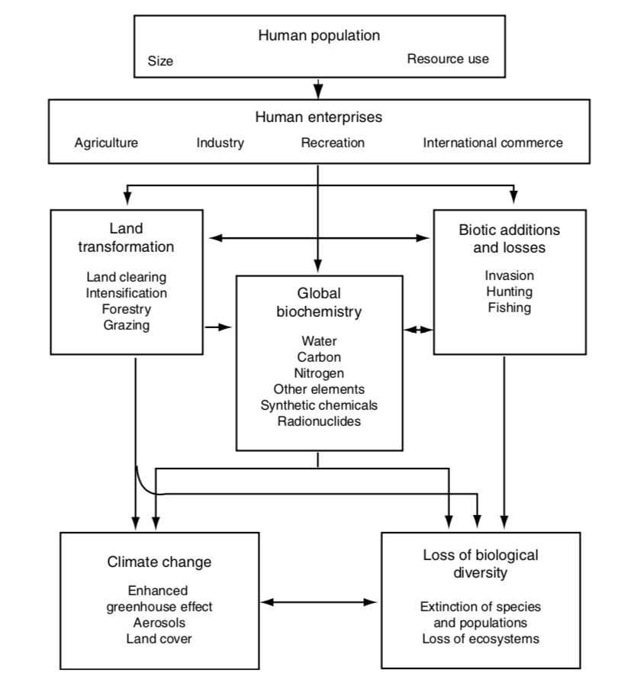
Direct and indirect impacts of humans on Earth’s ecosystems

Slide 3
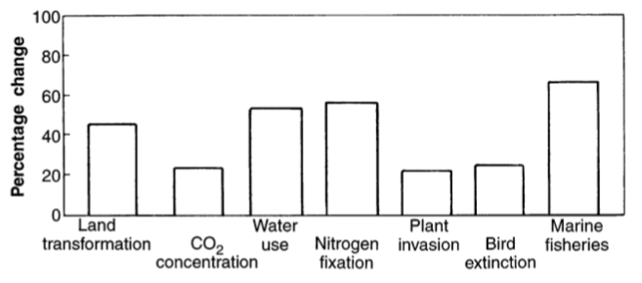
Human impact is not insignificant

Slide 4
Were any of the facts presented particularly surprising??

Slide 5
Direct and indirect impacts of humans on Earth’s ecosystems

Slide 6
Direct and indirect impacts of humans on Earth’s ecosystems

Slide 7
Land transformation
Nearly 50% of all land has been transformed by humans
Primary driver of species loss
20% of all CO₂ emissions
NASA
Border between Haiti (left) and Dominican Republic (right)

Slide 8
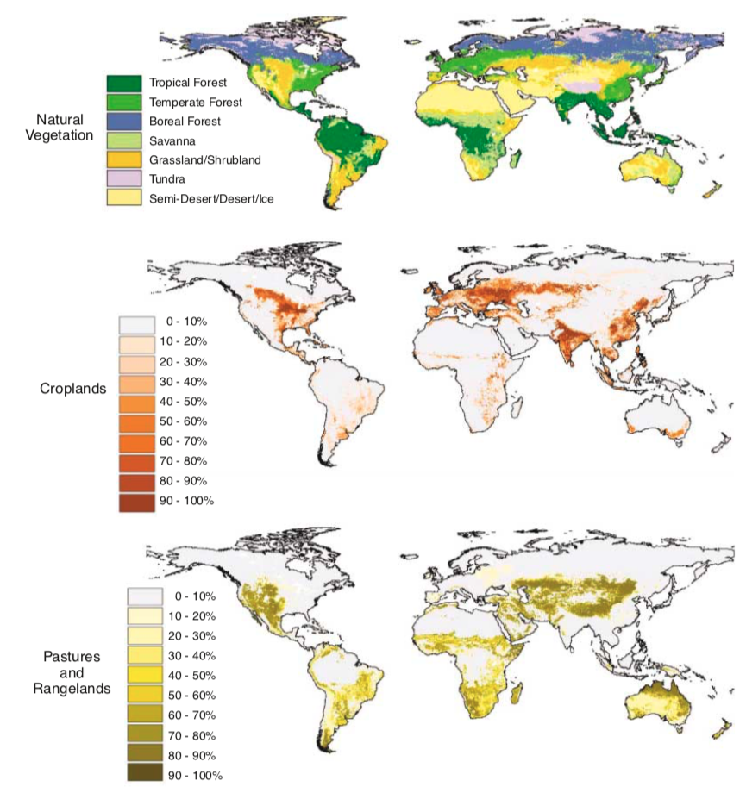
Foley et al. (2005)

Slide 9
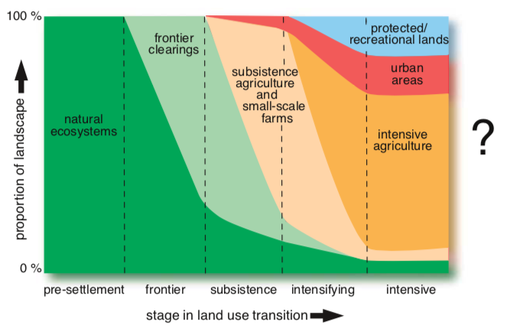
Progressive land transformation (Foley et al. 2005)

Slide 10
Direct and indirect impacts of humans on Earth’s ecosystems

Slide 11
Biogeochemistry - Carbon
Humans emit 5,500,000 tons of C per year
Ecosystems take up only 2,300,000 tons per year
Impacts
Climate change
Ocean acidification
Decreased food quality

Slide 12
Biogeochemistry - Water
Humans use 50% of accessible freshwater
70% of that in agriculture!

Slide 13
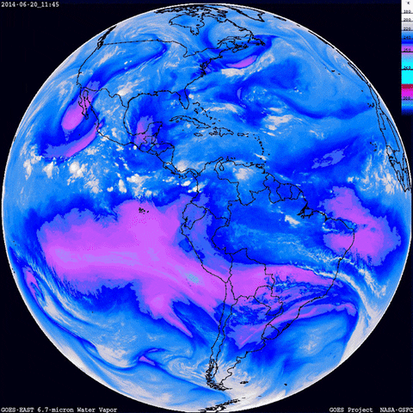
Biogeochemistry - Water
Humans use 50% of accessible freshwater
70% of that in agriculture!
Water travels long distances
Water use can impact climate locally and far away

Slide 14
Biogeochemistry - Nitrogen
Human activities add as much fixed N to terrestrial ecosystems as all natural sources combined!
Where does it come from?
USDA

Slide 15
Biogeochemistry - Nitrogen
Human activities add as much fixed N to terrestrial ecosystems as all natural sources combined!
Where does it come from?
N saturation – not all N can be taken up
Where does it go?
USDA

Slide 16
Direct and indirect impacts of humans on Earth’s ecosystems

Slide 17
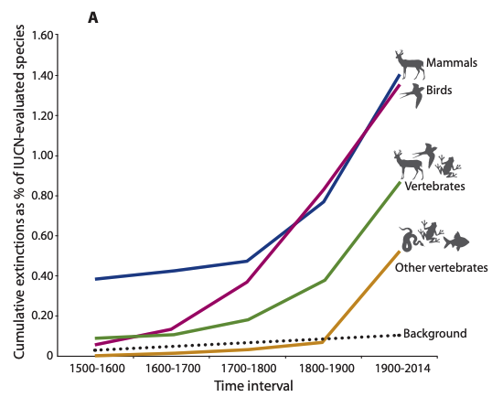
Biotic change – Species loss
Percent of extinct species
(note the background rate)
Ceballos et al. (2015)

Slide 18
Biotic Changes – Species Loss
The number of species increases with space
Pimm et al. (2014)

Slide 19
Biotic Changes - Invasion
Invasive species are threatening all across the globe.
What might explain these patterns?
Early et al. (2016)

Slide 20
Biotic Changes - Invasion
Early et al. (2016)

Slide 21
Biotic Changes - Invasion
Early et al. (2016)

Slide 22
Direct and indirect impacts of humans on Earth’s ecosystems
Anything missing??

Slide 23
Some things to chat about

Slide 24
1. Who pays the cost?

Slide 25
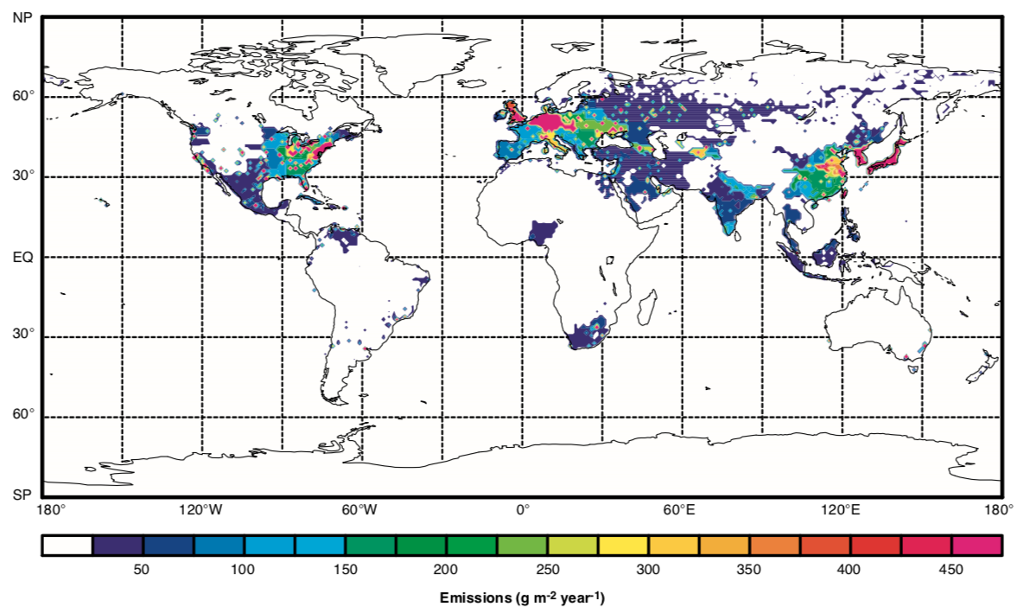
Global CO₂ emissions

Slide 26
The Guardian

Slide 27
Are consequences paid by the perpetrators?
The Guardian

Slide 28
How should we regulate this?
The Guardian

Slide 29
Example of international cooperation: the Montreal Protocol
1990 protocol to stop use of chlorofluorocarbons (CFCs)
CFCs deplete the ozone layer
Banned CFCs
By 2000 in developed countries
By 2010 in non-developed countries
NOAA

Slide 30
2. What would the world look like without humans?

Slide 31
“There is no clearer illustration of the extent of human dominance of Earth than the fact that maintaining diversity of “wild” species and the functioning of “wild” ecosystems will require increasing human involvement”
Vitousek et al. (1997)

Slide 32
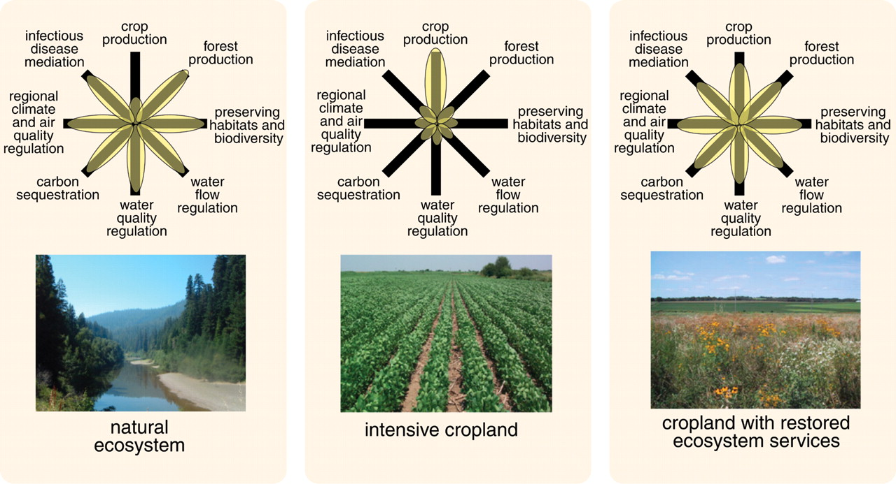
Foley et al. (2005)

